Slide 1

Welcome to Post Service Officer School September 20, 2025
William Genochio
VBA coordinator, Department Service Officer Cleveland VA Regional Office

Slide 2
House Keeping
Bathrooms are in the hallway. If you need to use the Restroom or need to take a break, please exit the room quietly. Also across the hall is the break room with coffee and water.
Please ensure that your Cell Phones are on silent. If your phone goes off. I think a donation to Veterans Affairs and Rehabilitation Pillar is warranted.
If you have questions during the training, please raise your hand the instructor will call on you for your question. Remember the only bad question is a question not asked.
When asking your question’s if it regards a specific veteran, please keep names out of the question. We want to respect their privacy. This goes for questions regarding your own claim or situation.

Slide 3

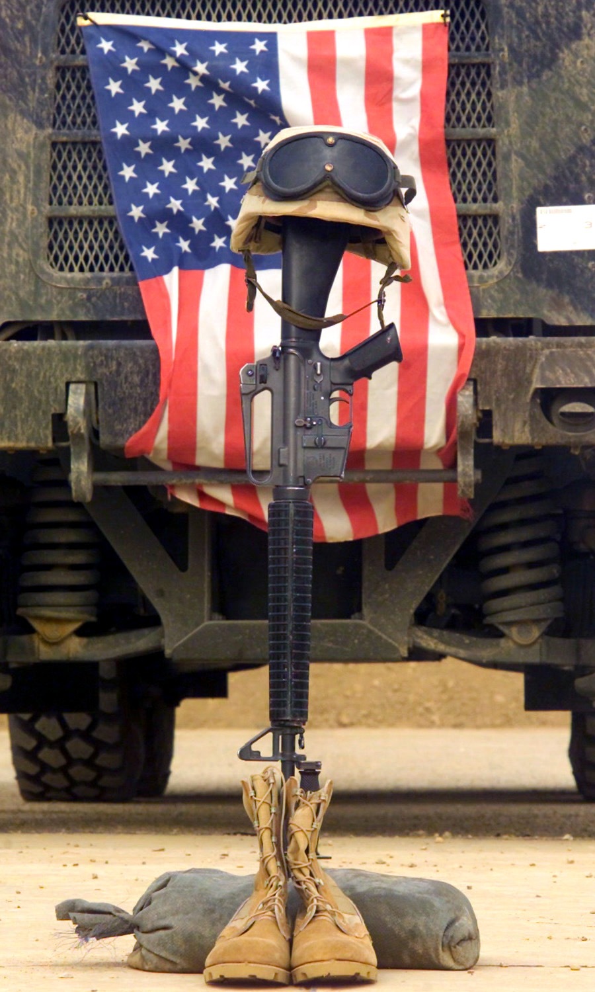
Will Brown, Department Service Officer Cleveland VA Regional Office. Will lead us in Prayer.

Slide 4

PLEDGE OF ALLEGIANCE
Department Service Officer, Cleveland VA Regional Office Tom White will lead us in the Pledge of Allegiance.

Slide 5
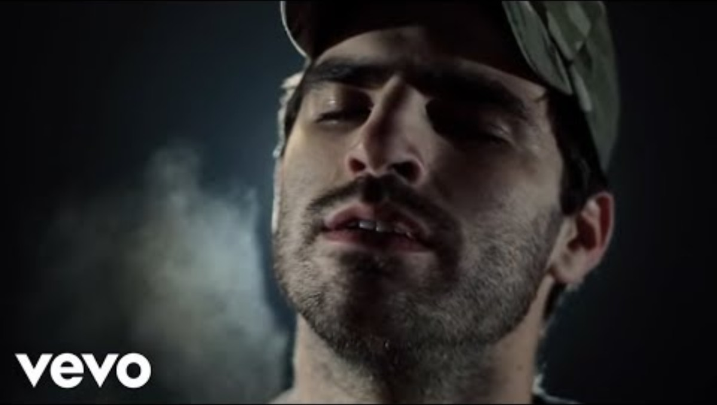

Slide 6
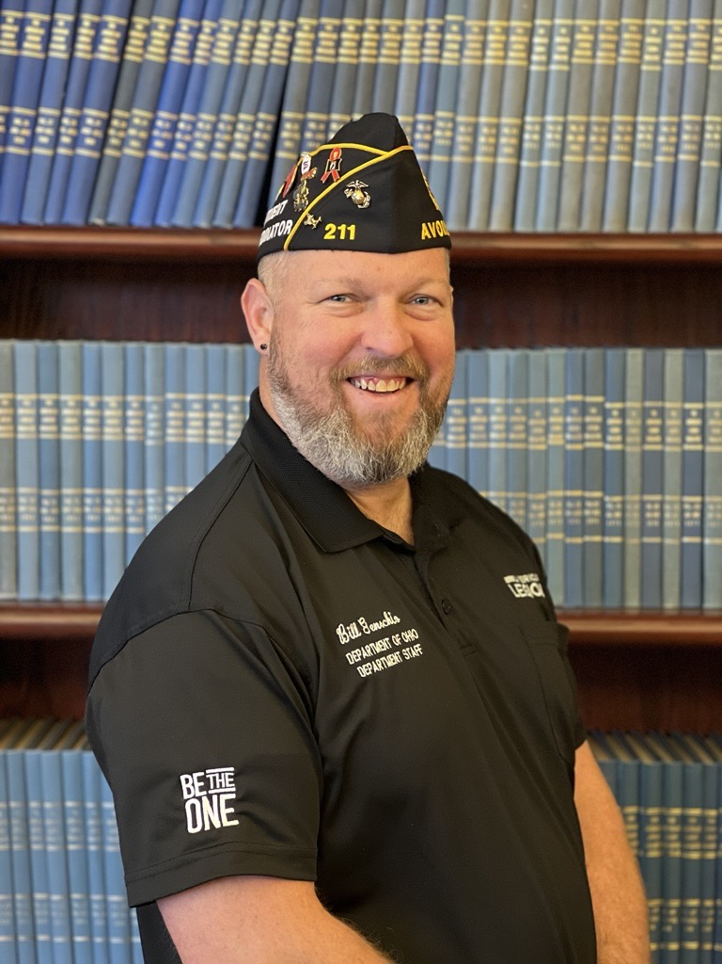
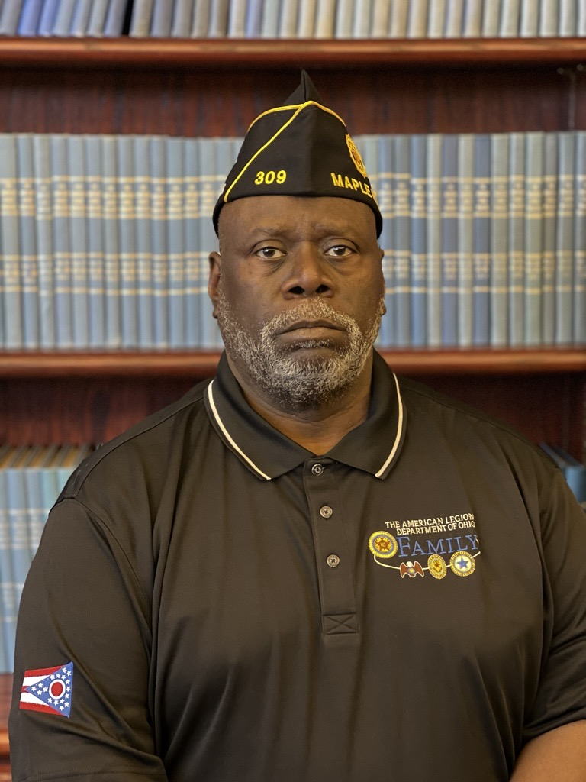
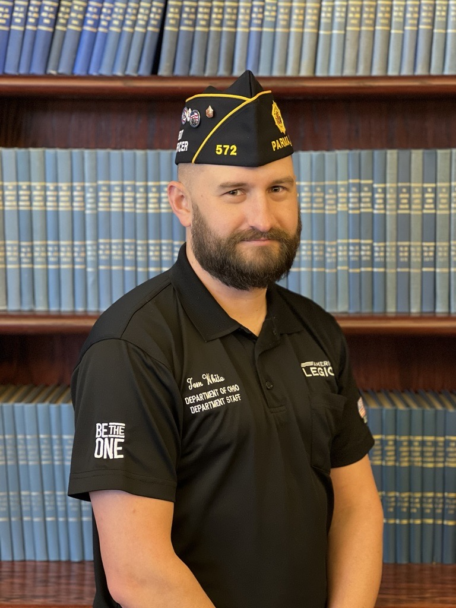


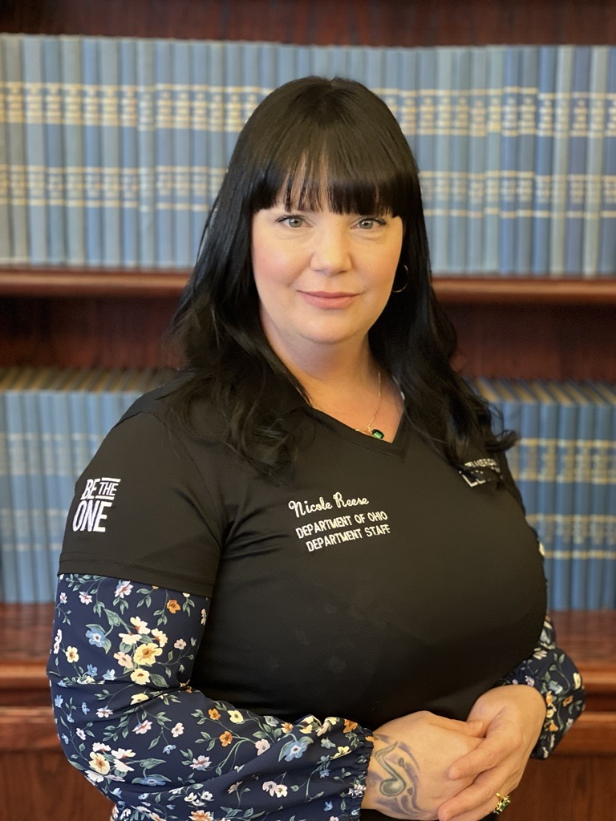
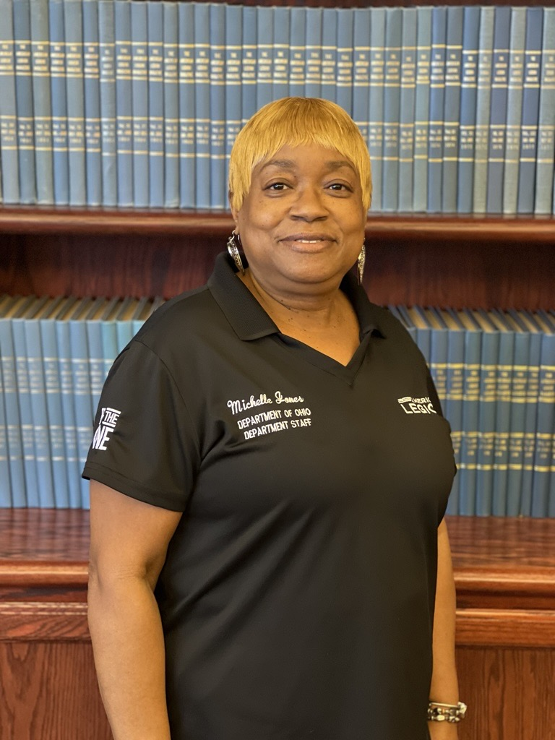
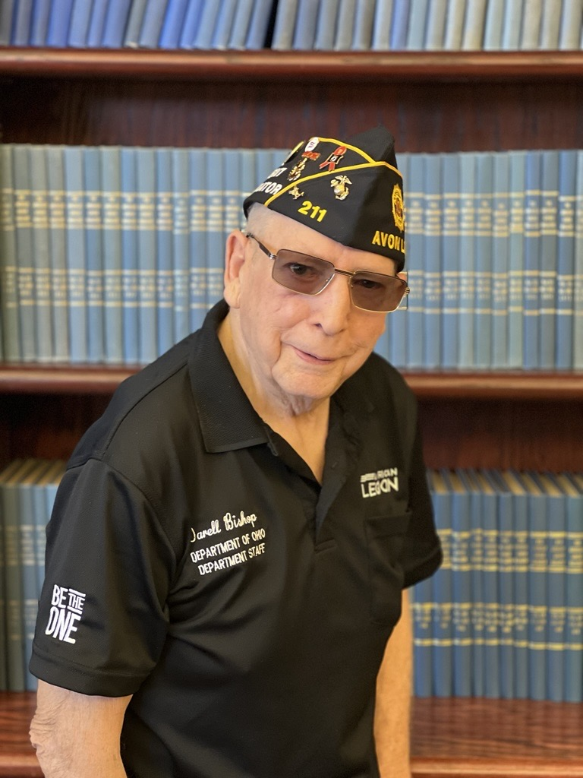

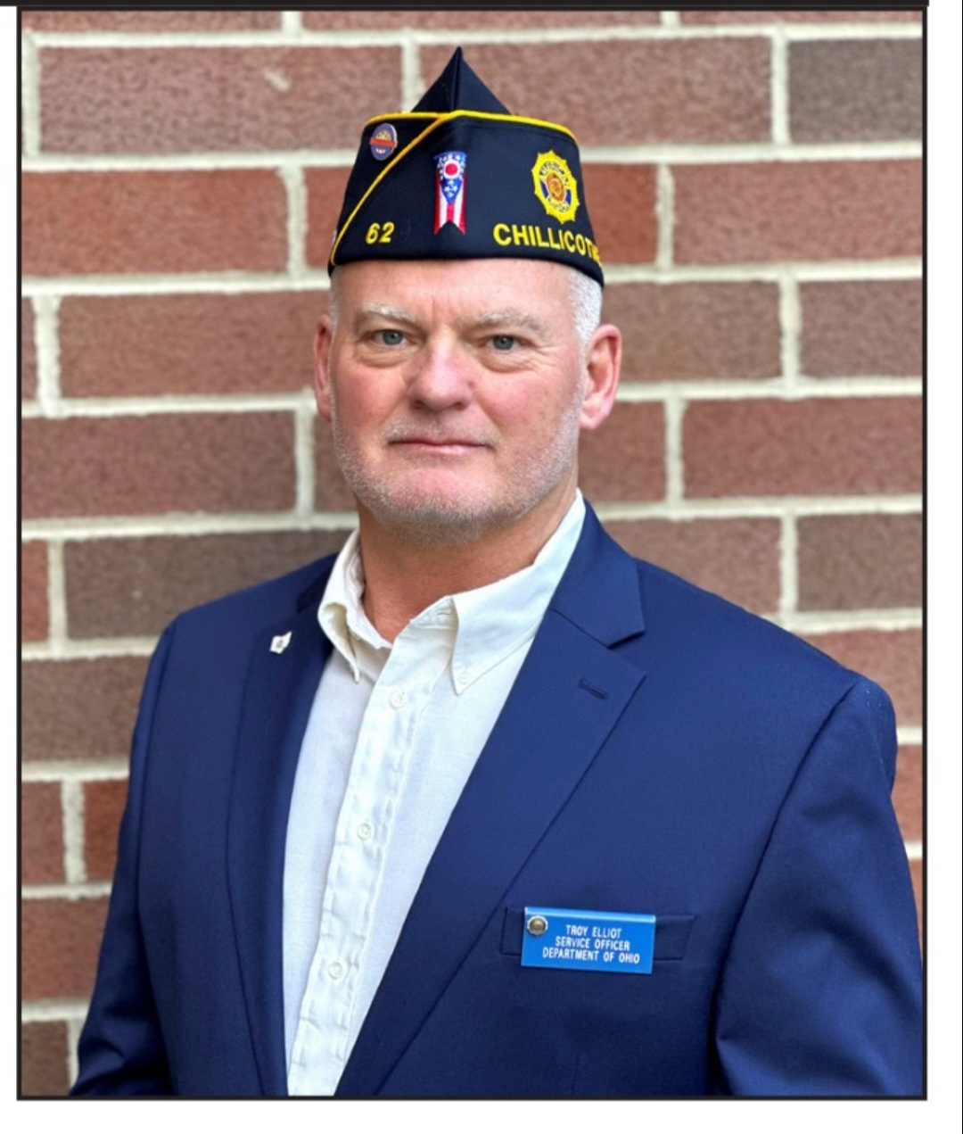
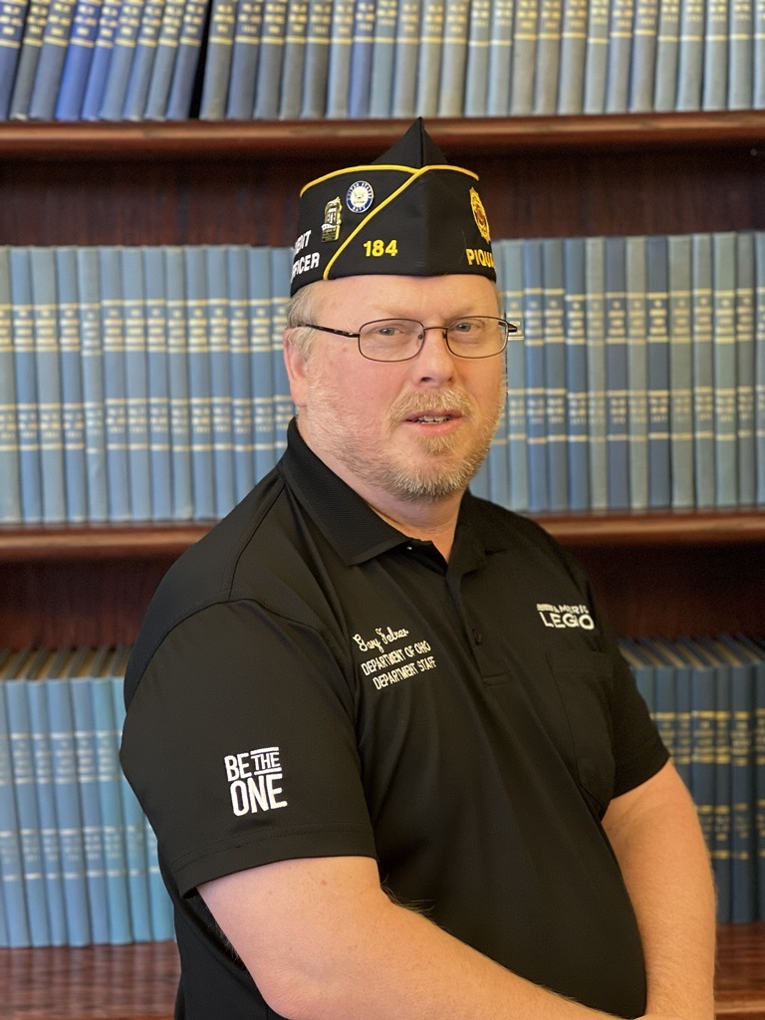
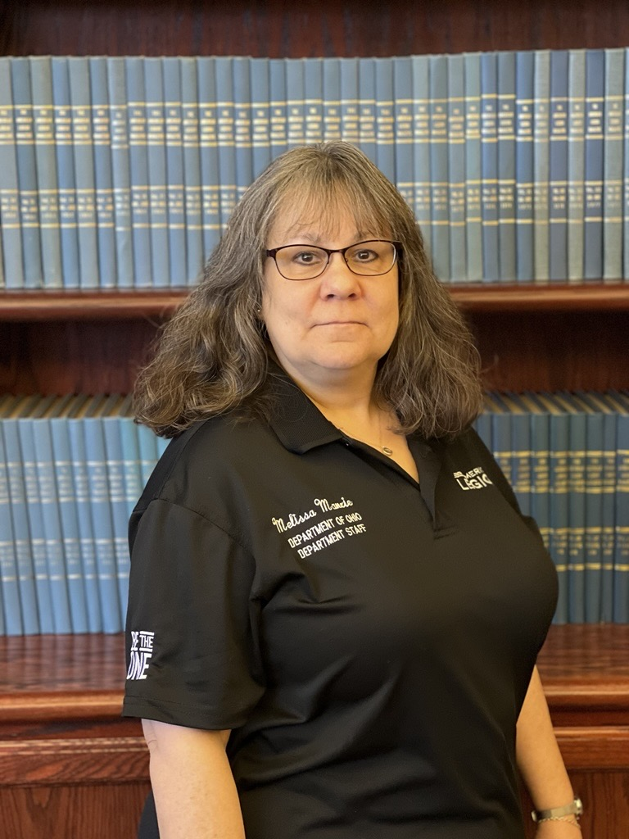
Department Service Officer Team
American Legion Department of Ohio
Department Service Officer Team 2025
William “Bill” Genochio, VBA Coordinator, Cleveland VA Regional Office 216-522-3504 ext. 53746, Genochio@ohiolegion.com or william.Genochio@va.gov
Will Brown, DSO Cleveland VA Regional Office, 216-522-3504 ext. 53745 brown@ohiolegion.com or will.brown@va.gov
Thomas White, DSO Cleveland VA Regional Office, 216-522-3504 ext. 53743 twhite@ohiolegion.com or Thomas.white@va.gov
Jessica “Nicole” Reese, DSO Cleveland VA Regional Office, 216-522-3504 ext 53741 jreese@ohiolegion.com or Jessica.reese@va.gov
Michelle Jones, DSO Cleveland VA Regional Office, 216-522-3504 ext 53747 jones@ohiolegion.com or michelle.jones6@va.gov
Darell Bishop, DSO Wade Park VAMC, 216-791-3800 ext 64154 dbishop@ohiolegion.com or darell.bishop@va.gov
Gary Felver, DSO Cincinnati VAMC, 937-268-6511 ext 2967 gfelver@ohiolegion.com or gary.felver@va.gov
Troy Elliott, DSO Chillicothe VAMC, 740-773-1141 ext 16252 telliott@ohiolegion.com or troy.Elliott@va.gov
Melissa Manzie, Administrative Assistant, Cleveland VA Regional Office, 215-522-3504 ext 53748 mmanzie@ohiolegion.com or melissa.Manzie@va.gov

Slide 7
What is a Post Service Officer and what do they do

Slide 8
What is a Post Service Officer
The American Legion’s post service officer (PSO) is a volunteer position within an individual post. A PSO serves as a link between the veteran or dependent and a representative holding American Legion accreditation. An effective PSO understands benefits afforded to veterans and dependents; however, the PSO is not authorized to file any claims on behalf of the claimant. PSOs serve as valuable resources to veterans in local posts to ensure that our veterans and their dependents receive their earned benefits.

Slide 9
Post Service Officer Need to Know
Each PSO should have readily available the contact information for various resources in their local area that could be beneficial to veterans and their dependents. These resources can include, but are not limited to:
American Legion department service officer (DSO)
• County/local representatives with American Legion accreditation
• Agencies for senior citizens
• State and local nursing homes
• Homeless shelters
• State and National cemeteries
• Department of Veterans Affairs contact information, including phone numbers and website addresses

Slide 10
PSO and DSO Relationship
Veterans’ claims are adjudicated at a VA regional office (VARO); these offices are located throughout the nation. The American Legion has DSOs located at each VARO dedicated to effectively advocating for veterans and their family members. To provide greater assistance to veterans, it is incumbent upon the PSO to develop a strong working relationship with the DSO to ensure the highest quality service. Though the DSO cannot discuss specifics regarding each veteran’s claim, the DSO can provide the following information that will be helpful to the veteran and allow the PSO to provide a higher level of assistance:
• Reception of information pertinent to claim (forms, letters, etc.).
• Remind the veteran of upcoming appointments.
• Provide/locate transportation for veterans requiring services

Slide 11
Difference Between a PSO and DSO (Accredited Representative)
Action | PSO | DSO
Provide general advice/guidance concerning VA Benefits | X | X
Provide advice and assistance with obtaining State or local benefits | X | X
Help the veteran / claimant complete forms |  | X
Sign VA Form 21-22 |  | X
Represent Claimants at VA hearings |  | X
Request status from VA and speak to VA on veterans Behalf |  | X
Accept and submit PII and VA Forms |  | X
Sign forms on behalf of veteran / claimant |  | X

Slide 12

Membership Benefit
While The American Legion does not require membership to assist veterans, we do encourage PSOs and DSOs to have information available to inquiring veterans. Many veterans are unaware of the services The American Legion provides; upon working with dedicated PSOs and DSOs, many ask questions pertaining to membership. The American Legion is only as strong as its membership and volunteers; as a result, we encourage our service officers to have the information readily available and welcome them to the organization.

Slide 13

CLAIM SHARKS

Slide 14
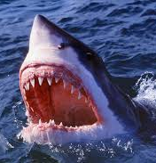
Claim Sharks
A Claim Shark is someone that takes advantage of veterans and their families by “consulting” or “assisting” them as they file their VA Claim. These Claim Sharks are not accredited through the VA Office of General Counsel and often charge high fees for their exploitative and unethical practices.
Again, Claim Sharks are not VA accredited meaning they are not required to adhere to the ethical standards that accreditation brings allowing their advice to be misleading or fraudulent.

Slide 15
How to Protect Veterans from Claim Sharks
Only work with Accredited Department Service Officer / County Veteran Service Officers
Don’t sign any monetary Contract for claims assistance
Do not provide access to your VA.gov account
To learn more about claim shark's visit: https://news.va.gov/126030/va-shares-tips-protect-benefits-from-fraud/

Slide 16

Know the American Legion
The American Legion is comprised of Four Pillars Veterans Affairs &Rehabilitation, Children & Youth, Americanism, and National Security

Slide 17
Veterans Affairs & Rehabilitation
The American Legion has for over 100 years acted as the nation’s leading advocate for proper health care, economic opportunity and legal benefits for U.S. military veterans. The Legion was instrumental in the creation of the Veterans Administration in 1930 and an ardent supporter of its elevation to cabinet status when it became the Department of Veterans Affairs in 1989. The relationship between VA and The American Legion continues to evolve today.
Gifts for Yanks: “Gifts for Yanks” is a program of giving by Legionnaires within the State of Ohio, originally called “Gifts for the Yanks Who Gave”, since 1952 to our hospitalized veterans and VA facilities from members of The American Legion, The American Legion Auxiliary, and Sons of The American Legion. Gifts for Yanks committee.
Career Services for Veterans: The Department of Ohio’s Employment Committee, is a major part of the Veterans Affairs & Rehabilitation pillar, that works, specifically in that area. Employment Committee.
Coordinator: William Genochio
Chairman: David Cook Sr.
https://www.ohiolegion.com/veterans-affairs-rehabilitation/

Slide 18

Children & Youth
To contribute to the physical, mental, emotional and spiritual needs of children and youth through the dissemination of knowledge about new and innovative organizations and their programs.
The purpose of the committee is to formulate, recommend and implement plans, programs and activities designed to:
• Assure care and protection for the children of veterans.
• Improve conditions for all children and youth, with due concern for maintaining the integrity of the family home.
• Prevent social and physical ills of children and youth where possible. • Maintain a balanced program that provides for their physical, emotional, intellectual and spiritual needs.
Programs in Ohio: 4th Grade Flag Education Program, Child Welfare Foundation, Temporary Financial Assistance, and Special Olympics
Coordinator: Christie White
Chairman: Ken P. Schutz
https://www.ohiolegion.com/programs/children-youth/

Slide 19

Americanism
The American Legion is an organization dedicated to God and country, with a membership of military veterans who take deep pride in the U.S. Flag and all that it means. Since its inception over 100 years ago, the Legion has been a stalwart champion of patriotic values, morals, culture and citizenship. The Legion’s pillar of Americanism embodies its devotion to law and order, the raising of wholesome youth, educated and law-abiding citizenship, and respectful observance of patriotic holidays and remembrances.
Ohio Programs: Americanism & Government Test and Trip Program, Buckeye Boys State, Oratorical Contest, Dayton and Western Reserve National Cemetery Graves Decorating Program, Scouts, Educator of the Year, Legion Baseball, Citizens Falg Alliance, and United States Flag Education / Etiquette.
Coordinator: Christe White
Chairman: Tom Rowe Jr.
https://www.ohiolegion.com/americanism/

Slide 20
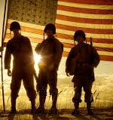
National Security
The Commission is responsible for reviewing items pertaining to various security issues that involve such items as cyber security, security of our boarders, our armed forces, their equipment and numbers so we don’t get into a position where we can’t maintain our presence in areas needed to ensure our safety. The Commission is also involved in military benefits and quality of life items that face our armed forces as well as the veterans that have served. These issues are addressed by either creating Resolutions to address the items or approve submitted resolutions by other committees or individuals. These resolutions are presented at the department convention to be accepted and once accepted, move on to the national convention. If the resolution is passed at the national level, it will then be presented to congress for possible action.
Programs: Operation Comfort Warrior, National Emergency Fund, and POW/MIA Advocacy
Coordinator: Jacob Brault
Chairman: Al Buxton
https://www.ohiolegion.com/national-security/

Slide 21
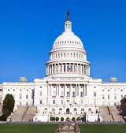
Legislative
The mission of the Legislative Committee is to review all State, Federal, House, and Senate Bills pending to gauge the level of support from The American Legion Department of Ohio. To communicate with the Legislative Liaison and Service Director who performs lobbying tasks on behalf of the 80K+ Legionnaires within Ohio.
Coordinator: Jacob Brault
Chairman: Michael D. White
https://www.ohiolegion.com/legislative/

Slide 22

Department of Ohio Organizational Flow Chart
Department Convention
Department Executive Committee
Department Commander
Stan Oren
PDC: A.J. Whatley
Dept. Judge Advocate: Jason Rue
Assistant Judge Advocate: Chris Emmons
Parliamentarian : Gary Minadeo
Dept. Treasurer: Ken LaVoy
Dept. Chaplin: Ronald Distel
Dept Assistant Chaplin: Sharon McClain
Dept. Historian: Kevin Motter
Assistant Historian: Robert Mason
Dept. Sergeant-at-Arms: Mike Kennedy
NEC: Ronald Chapman
Alt. NEC: Robert Schmidt
1st Vice Commander
Gary Cox Jr.
2nd Vice Commander
Holly Lewis
Department Adjutant
J.D. Robinson
Department Staff:
Executive Admin Assistant: Vacant
Front Desk Administrator: Hope Eaton
Membership Manager: Sherry Yockey
Fiscal Officer: Rebecca Corbin
Fiscal Secretary: Cassie Lee
Americanism and Children and Youth Coordinator: Christie White
Membership SAL Post activities Coordinator: John Robinson
Media/Communications and Marketing Coordinator: Jon Vulgamore
Legislative and National Security Coordinator: Jacob Brault
Veterans Benefits Admi. Coordinator: Bill Genochio
Department Service Officers: Cleveland Bill Genochio, Will Brown, Michelle Jones, Tom White and Nicole Reese: Cincinnati VAMC Vacant: Dayton VAMC Gary Felver, Chillicothe Troy Elliott
Charities Inc.: Shirley Espenshade
Department Commissions and Committees:
Veterans Affairs & Rehabilitation Committee
Gifts for Yanks Committee
Employment Committee
National Security Committee
Legislative Committee
Membership Committee
Americanism Committee
Religious Committee
Children and Youth Committee
Public Relations Committee
Law & Order Committee
Oratorical Committee
Special Olympics Committee
Baseball Committee
Environment Conservation Committee
Media, Marketing & Communications Commission

Slide 23
District Commanders and 1st Vice Commander
DISTRICT | COMMANDER | 1ST VICE COMMANDER
Great First District | Dean E. Boyer | Burnell (Bernie) C. Rau
Second “To None” | Timothy Wayne Shaw | Kurt D. Emans
“Thundering Third” | Brian W. Fowle | Michael D. White
“Fabulous Fourth” | Champ C. Brown | Steven A Baumann
“Fighting Fifth” | Melissa R. Rodgers | Kenneth M. Parsons
Sizzlin’ Sixth | William (Will) C. Little | Keith Smigle
“Magnificent Seventh” | Johnny R. Conley | Douglas A. Boyd Sr.
“Great” Eight | Scott M. Conn | Ronnie (Ron) Rutter
“Dynamic” Ninth | Samuel Swoger III | William (Bill) R. Ditterbrand
“Great” Tenth | Thomas D. Barnett | Howard F. Stouffer
“Elite” Eleventh | David Taylor | Richard L. Smathers
“Capital” Twelfth | Suzette Heller | Vacant
“Tenacious” Thirteenth | James G. Lockyer | Kevin D. Conlan
“Phenomenal” Fourteenth | John J. Life | Jacon Marx

Slide 24
VA ORGANIZATIONAL
Department of Veterans Affairs
Veterans Benefits Administration
Veterans Health Administration
Veterans Cemetery Administration
Administrations communicate very little with each other –
Services received at the VHA facility does not guarantee or imply VBA is aware or will take action
VBA initiates a C&P exam to VHA based on claims filed by DSO/CVSO
All evidence with VHA is subject to being reviewed by VBA – ONLY if veteran discloses at facility

Slide 25


VBA Coordinator, Department Service Officer
William Genochio III, GySgt, USMC (Retired)
william.Genochio@va.gov
genochio@ohiolegion.com
Office: 216-522-3504
Cell: 740-816-7589

