Slide 1

Membership Recruiting & Retention
Mid-Winter Conference Training 2018

Slide 2
Membership Recruiting
Recruiting

Slide 3
Facilitator
Rob Hail - Membership Manger
membership@ohiolegion.com

Slide 4
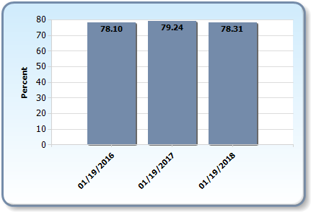
Ohio 3-Year Membership Comparison as of January, 19 2018
Renewals

Slide 5
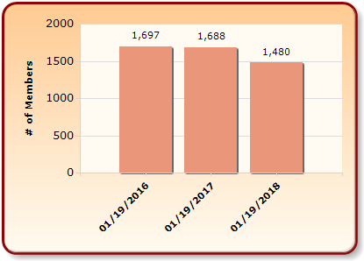
Ohio 3-Year Membership Comparison as of January, 19 2018
Traditional New Members

Slide 6
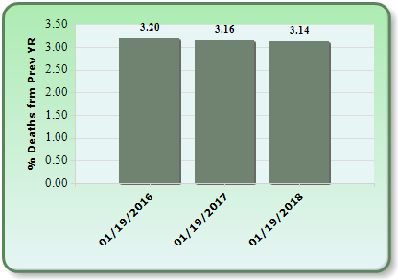
Ohio 3-Year Membership Comparison as of January, 19 2018
Death Rate

Slide 7
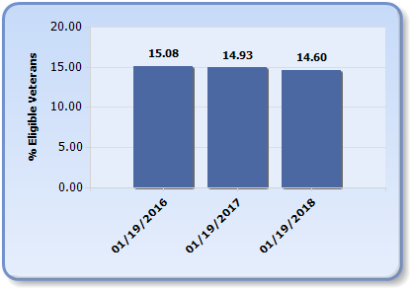
Ohio 3-Year Membership Comparison as of January, 19 2018
Market Penetration

Slide 8

Ohio 3-Year Membership Comparison as of January, 19 2018
Active Members by War Era

Slide 9

Ohio 3-Year Membership Comparison as of January, 19 2018
Deceased Members by War Era

Slide 10
I want You to be a Legion Family Member

Slide 11
Recruiting Best Practices
Always be ready with a 30 second ‘elevator pitch’ on the importance and benefits of Legion membership.
Download the Legion app. You’ll be ready to sign up members on the spot. Keep a few membership applications handy.
Build and maintain a relationship with military installations. Refer to the publication Access Granted for details on how.

Slide 12
Recruiting Best Practices
Build and maintain a relationship with the person in charge of veteran admissions and/or veteran student organizations that may be on college campuses.
Network with first responders, civic and community organizations, as well as other veteran service organizations to expand your pool of potential members.
Ensure that your post is building its brand - make sure your post is an asset to the community; inform them of your post’s programs, participation in parades, service activities, etc.

Slide 13
Recruiting Best Practices
Don’t narrow your focus to veterans in only one or two war eras. Any veteran may be eligible, but you won’t know if you don’t ask!
Work your post’s Expired Members listings that can be found under the Find Members in my Area section on www.mylegion.org.
Don’t let all of your hard work go to waste - RETAIN THE MEMBERS YOU HAVE.

Slide 14
Recruiting Best Practices
RENEW, RETAIN AND RECRUIT

Slide 15
Membership Retention
Retention

Slide 16
Retention Best Practices
Have a program, not a campaign. Retention is a year-round priority and needs to be planned. Any post that is, or wants to be, successful at retention must be able to identify the specific steps it takes to increase its retention rate.
Recognize members who reach milestone membership anniversaries. If members stay in The American Legion for five, ten, twenty or more years, they are probably not among those who are likely to drop out

Slide 17
Retention Best Practices
Provide and encourage the use of The American Legion Emblem. There are good reasons for members to want to display the Legion emblem or other Legion artwork. The emblem can be an effective membership and marketing tool.
Accept credit and debit cards for dues payments. Credit and Debit card payments have become the norm for almost all purchasing transactions.

Slide 18
Retention Best Practices
Recognize your members as often as possible. Thank him or her for their participation in each and every program or function. Whether you do it formally or informally, it pays to express appreciation to members whenever possible. It's never too late to show gratitude to hard workers.
Get members involved at SOME level. Involved members don't drop. Your post needs to try to find ways to get members involved in a meaningful way without taking up too much of their time. This is especially true with newer members.

Slide 19
Recruiting & Retention
Conclusion - Q & A

